Slide 1

Evidence-based Interventions for Mental Health Conditions
Ielhaam Jacobs
Psychologist
Ekurhuleni Psychology Department

Slide 2
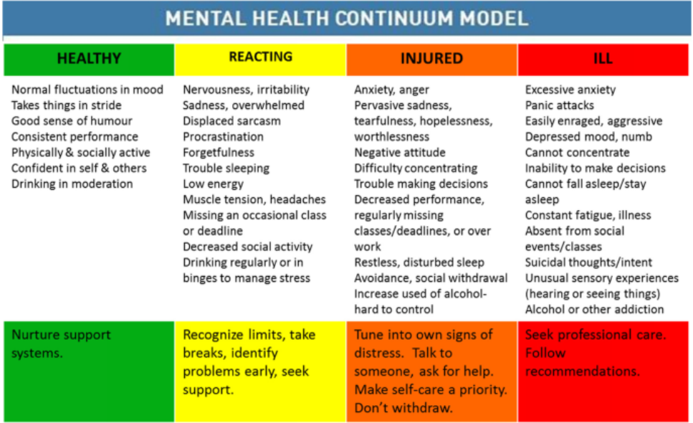
Assessing Mental Health
Notes:
Comprehensive assessment comprises of patient interview, collateral information, validated screening tools and clinician observations. Assessment then informs what level of intervention is necessary: promotion, prevention, treatment and rehabilitation

Slide 3
Strategies for Mood & Anxiety Disorders
Cognitive Behavioural Therapy – Behavioural activation, cognitive restructuring, gradual exposure
Mindfulness practices – focus on present moment as opposed to past of future
Interpersonal Psychotherapy – Exploration of relationships and social interactions and ways this may contribute to symptoms of depression
Acceptance and Commitment therapy – Assists getting “unstuck” from negative thoughts and feelings; Based on accepting difficult feelings/situations, being present, identifying values and committed action that aligns with these values

Slide 4
Screening Tools for Mood & Anxiety

Slide 5
Strategies for Post Traumatic Stress Disorder

Slide 6
Alcohol & Substance Use Disorders
Specialized field – assess and refer appropriately
Motivational Interviewing –
CBT, Including relapse prevention

